Slide 1
Measuring Internal Product Attributes - Structure
Prof Maheswari S
VIT Chennai

Slide 2
Types of structural measures
Control – flow structure – Sequence of flow
Data-flow structure - Behavior of the data
Data structure – Organization of the data

Slide 3
Control flow structure
Control flow measures are usually modeled with directed graphs.

Slide 4
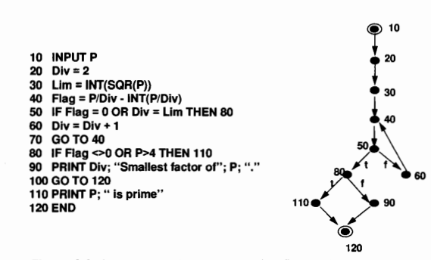
Example

Slide 5
Measured by static analysis and CASE tools
Notation to be used for the measurement is m(A)
Complexity can be measured

Slide 6
Flow graph model of structure
Graph – nodes and links or edges
Directed Graph
In-degree
Out-degree
Path
Simple path

Slide 7
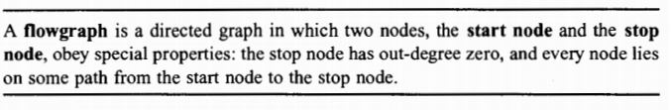
Definition

Slide 8
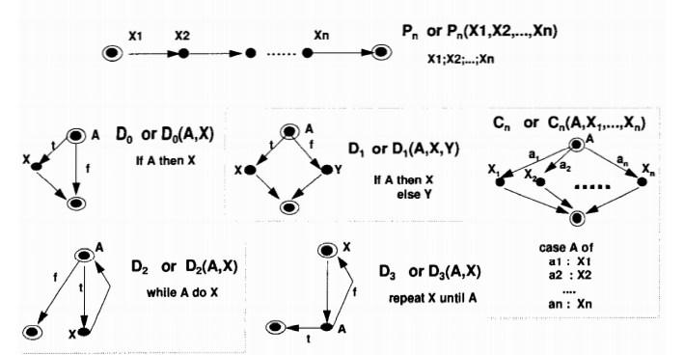
Flow graph for program structure models

Slide 9
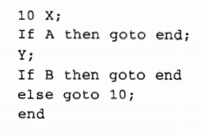
Example

Slide 10

D5?

Slide 11
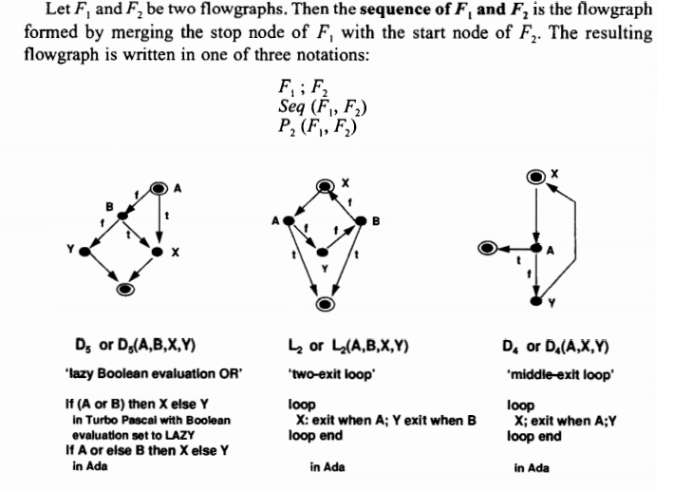
Sequencing and nesting

Slide 12
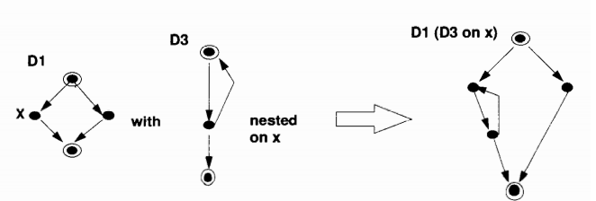
Applying the nesting operation

Slide 13
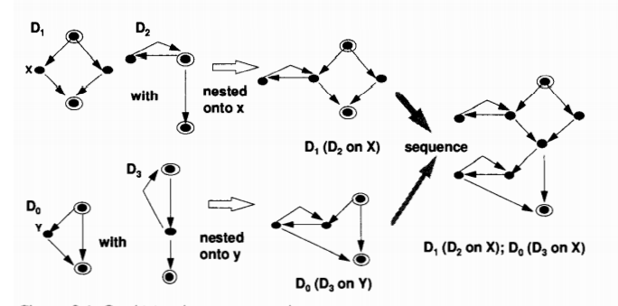
Combining sequence and nesting operations

Slide 14
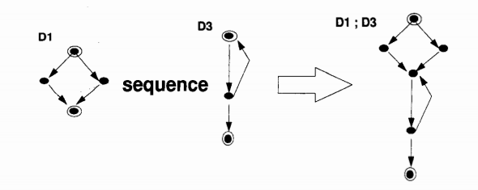
Applying the sequence operation

